Slide 1
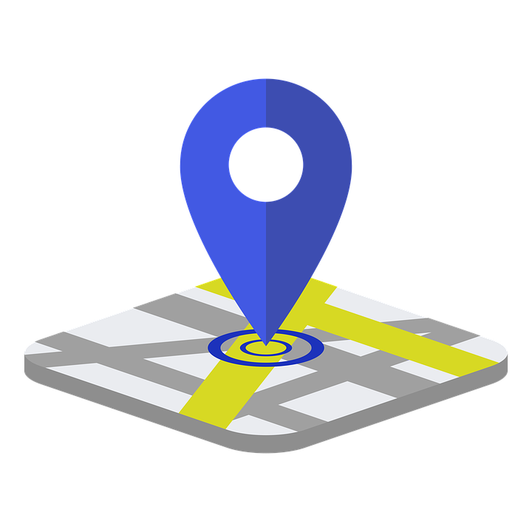
Women Safety Device With GPS Tracking and Alerts

Slide 2
INDEX
Title
Motivation
Introduction
key features
Methodology
Component list
Arduino nano – the core of the device
GPS module (NEO – 6M)
GSM Module (SIM800L)
Panic (push) button
Circuit diagram
Code overview
Application and use cases
Conclusion

Slide 3
Title
Title: Women’s Safety Device with GPS Tracking and Alerts
Subtitle: Powered by Arduino Nano
BY TEAM : A . REVANTH (12405228) (66)
: HARSHA SANTHOSH (12415757) (65)
: G. SRIDEEP REDDY (12414597) (64)

Slide 4
MOTIVATION :
The Need for Women’s Safety
Increasing Risk of Violence and Harassment: Women face a higher risk of physical violence, harassment, and assault in public spaces, especially when alone. A safety device can provide an immediate means of alerting authorities or loved ones during such incidents.
Lack of Immediate Help in Critical Situations: I n emergencies, women often don’t have enough time or opportunity to make a call for help. A quick-response safety device can send distress signals with real-time location tracking, ensuring faster intervention and assistance.
Empowerment and Peace of Mind: A safety device gives women the ability to take control of their own protection, knowing they have a reliable tool that can help them in dangerous situations. This empowerment provides confidence and peace of mind, allowing women to go about their daily activities without constantly feeling at risk.

Slide 5
KEY FEATURES :
Real-Time GPS Location Tracking
Functionality: The GPS module (e.g., Neo-6M GPS module) continuously tracks the location of the user via GPS satellites.
SMS Alerts with Location
Functionality: Once the SOS button is pressed, the device sends an SMS containing both a distress message and the GPS coordinates (latitude and longitude).

Slide 6
+------------------------+
| Power On Device |
+------------------------+
V
+------------------------+
| Initialize GPS Module | <--- GPS Module Initialized
+------------------------+
V
+----------------------------+
| Initialize GSM Module | <--- GSM Module Initialized
+----------------------------+
V
+-----------------------------+
| Wait for SOS Button Press | <--- User presses the SOS button
+-----------------------------+
V
+-------------------------------+
| Read GPS Coordinates |
+-------------------------------+
V
+--------------------------+
| Send SOS Alert SMS | <--- Send SMS with location info
+--------------------------+
V
+------------------------------------+
| Wait for Next SOS or Idle State |
+------------------------------------+
V
+------------------------+
| Power Off Device (If required) |
+------------------------+
METHODOLGY

Slide 7
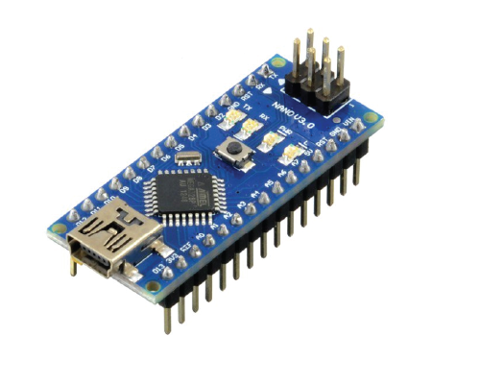
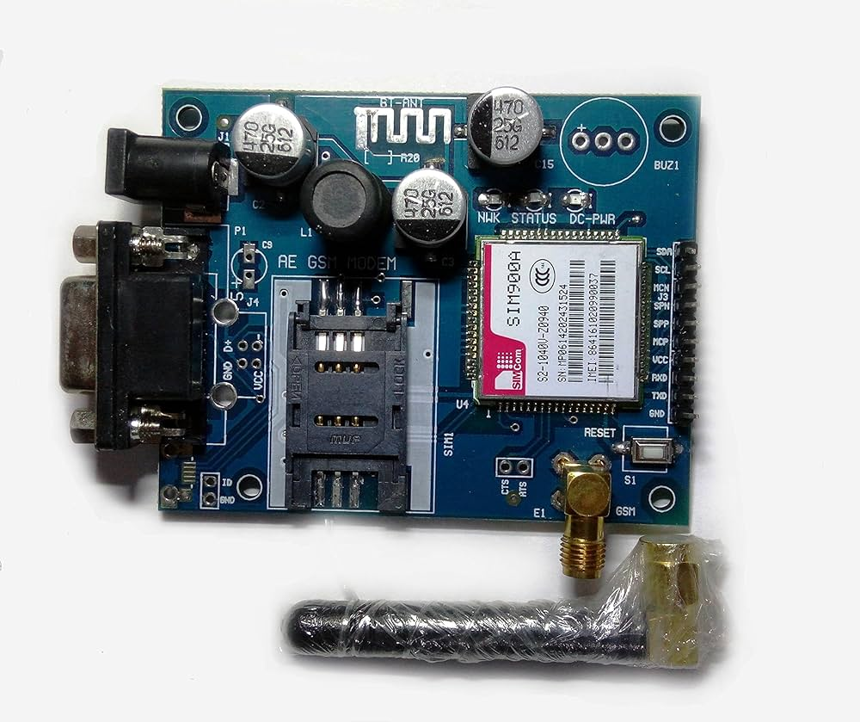
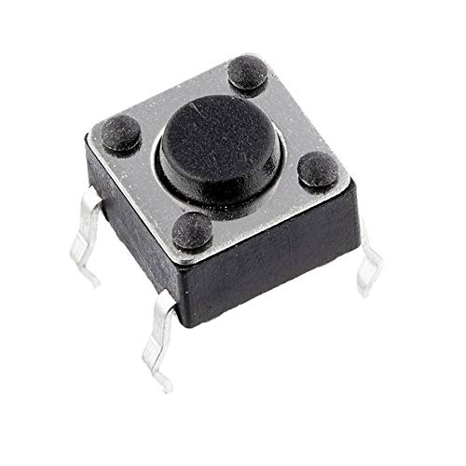
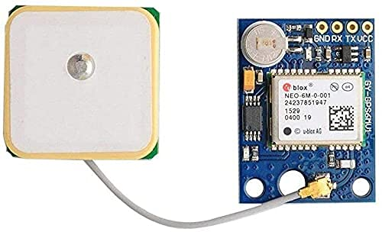
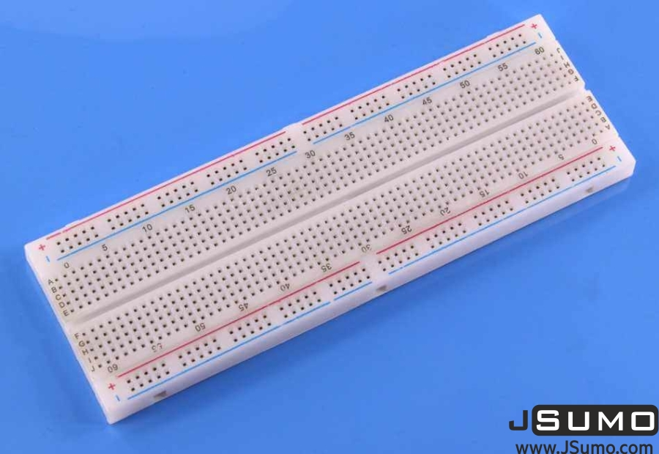
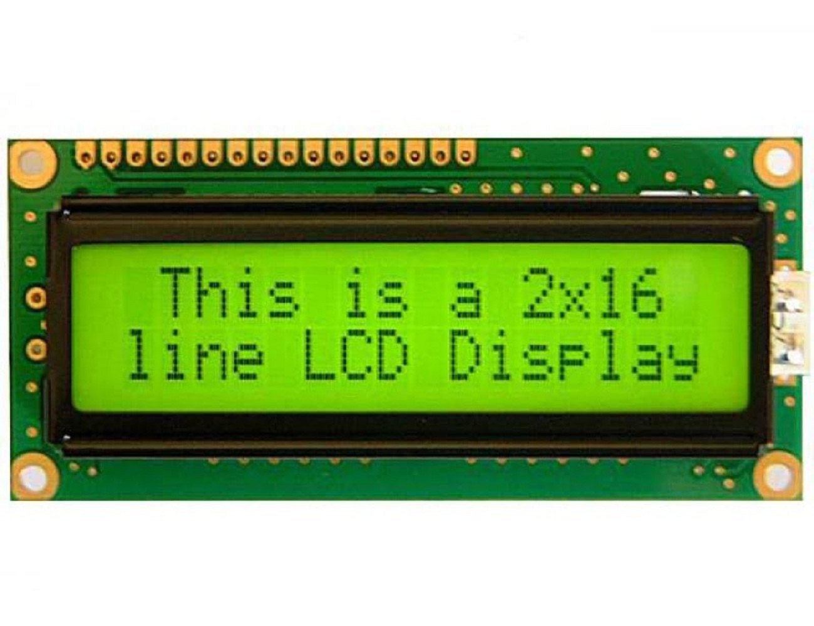
Components :
Arduino Nano
16x2 LCD
GSM Module
Neo 6M GPS Module
Push Button
Bread Board

Slide 8
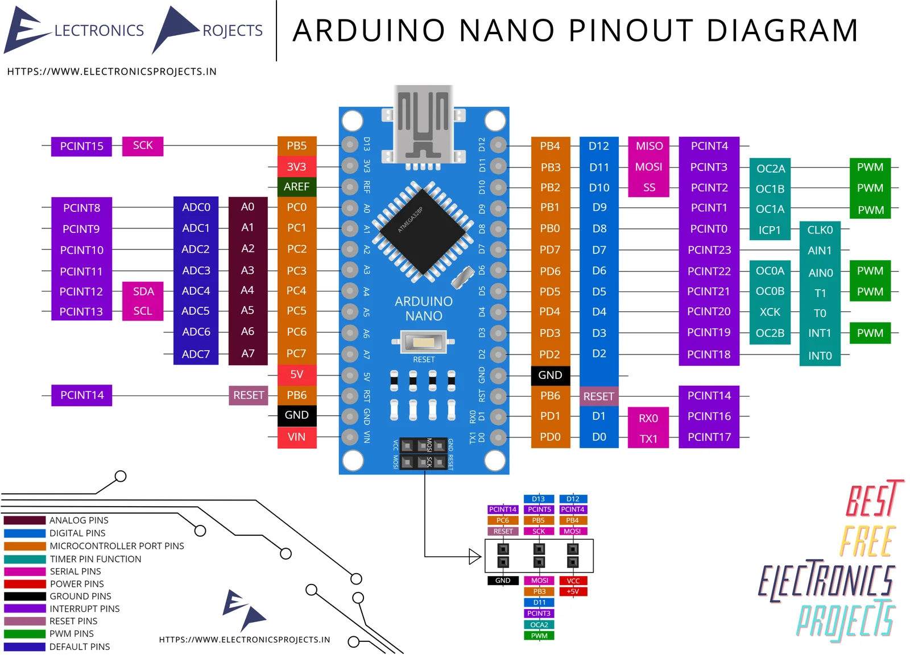
Arduino nano – the core of the device
The Arduino Nano is a compact, breadboard-friendly microcontroller board based on the ATmega328. It operates at 5V with a 16 MHz clock speed, features 14 digital I/O pins (6 PWM-capable), 8 analog inputs, and 32 KB flash memory. Ideal for space-limited projects like wearables, IoT devices, and small robotics, it’s cost-effective, low-power, and compatible with most Arduino libraries and software.

Slide 9
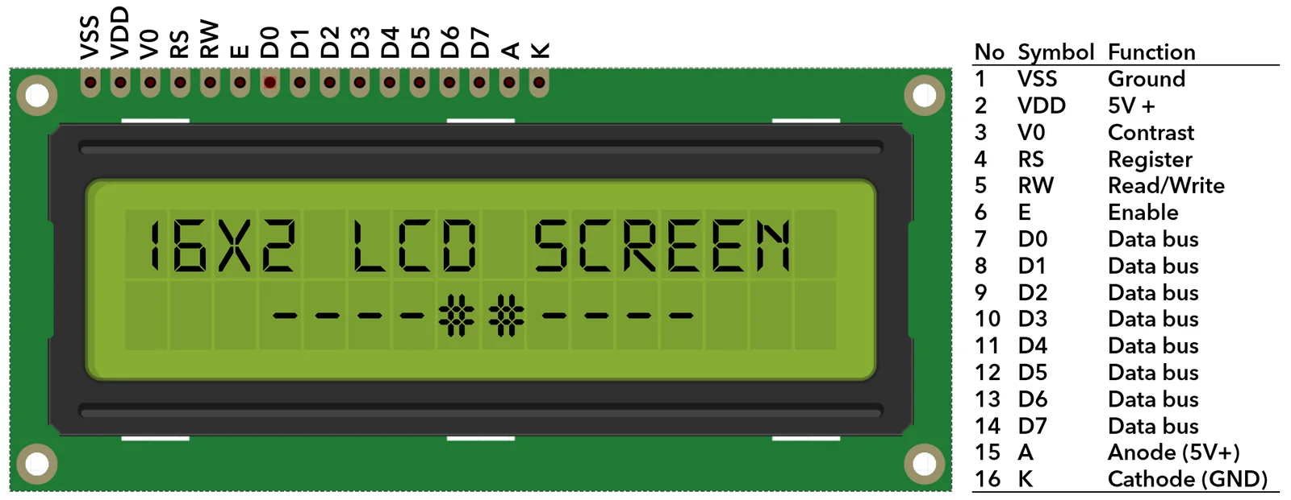
16X2 LCD DISPLAY
The 16x2 LCD Display is a basic, 2-line display module with 16 characters per line. It operates with 5V and is compatible with microcontrollers like Arduino. It uses the Hitachi HD44780 driver, which allows simple interfacing with 4 or 8 data pins. Commonly used to display text in electronics projects, it features adjustable backlight and contrast settings and is ideal for displaying messages, sensor data, or status updates.

Slide 10
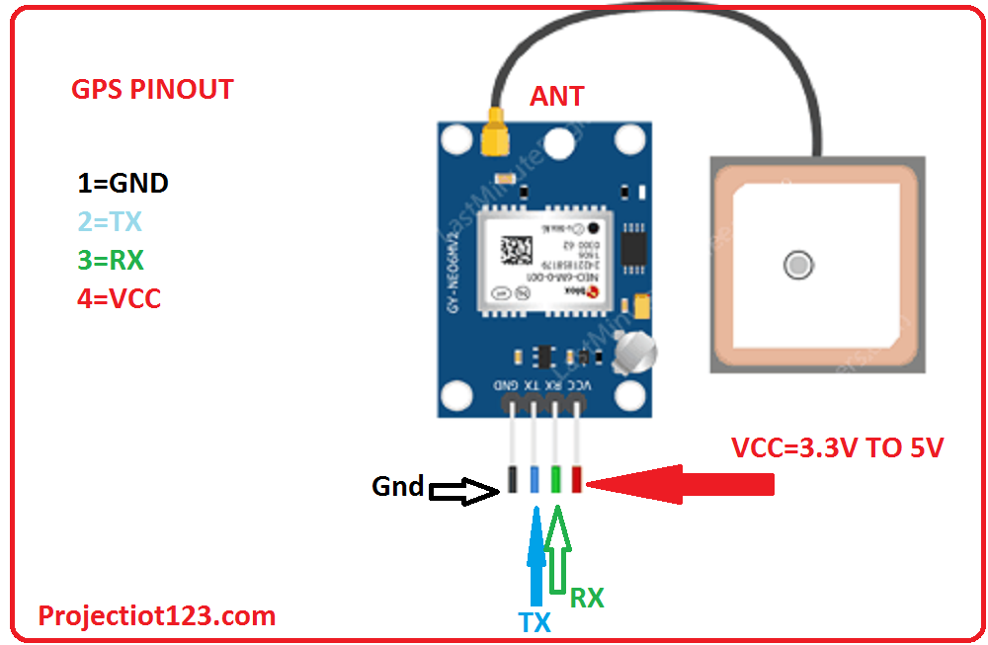
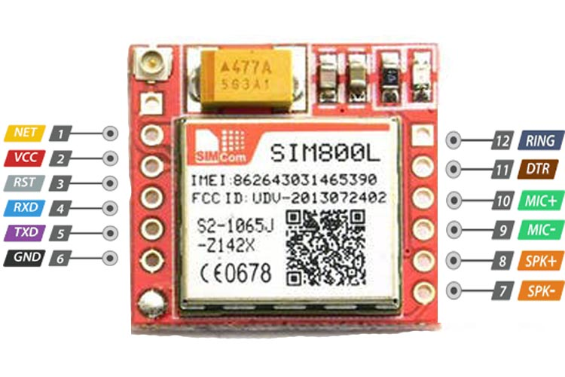
GPS Module: A GPS module provides Global Positioning System (GPS) functionality, receiving signals from satellites to determine location coordinates (latitude and longitude). Modules like Neo-6M offer real-time location tracking, commonly used in navigation, asset tracking, and autonomous vehicles.
GSM Module: A GSM module enables wireless communication using the Global System for Mobile Communications (GSM) network. It allows devices to send and receive SMS and make voice calls. Commonly used modules like SIM800 operate on 2G networks, making them popular for remote monitoring, IoT applications, and security systems.

Slide 11
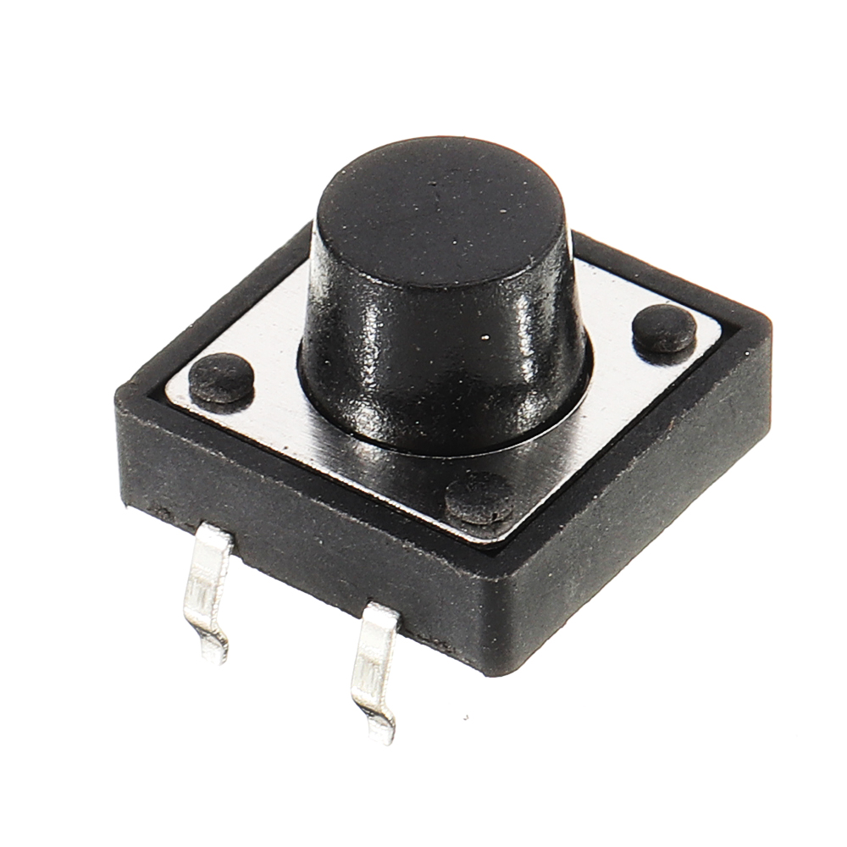
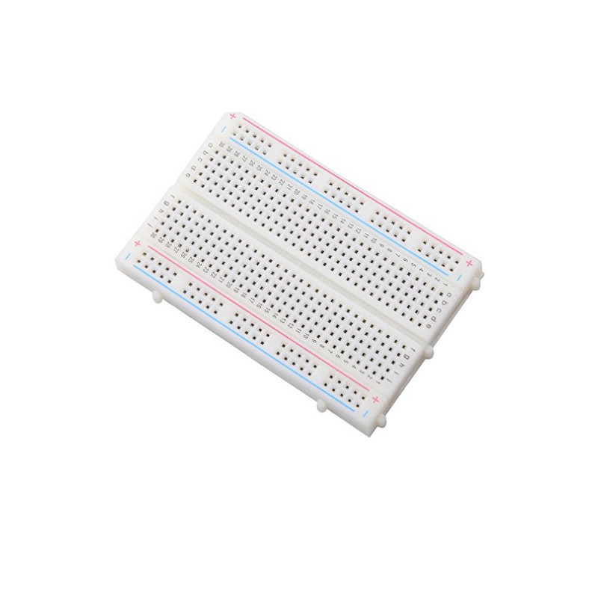
PUSH BUTTON :
A push button is a simple, mechanical switch that completes an electrical circuit when pressed. It typically has two states: pressed (closed) and released (open). Commonly used in electronics for user input, it sends a signal to a microcontroller (like an Arduino) when pressed. Applications include reset buttons, mode selection, and turning devices on/off.
BREADBOARD :
A breadboard is a reusable platform used for prototyping electronic circuits without soldering. It has a grid of holes with metal strips underneath that connect specific rows or columns, allowing components like resistors, LEDs, and microcontrollers to be easily inserted and connected. Breadboards are ideal for testing circuits and making quick modifications, making them popular for prototyping and learning electronics

Slide 12
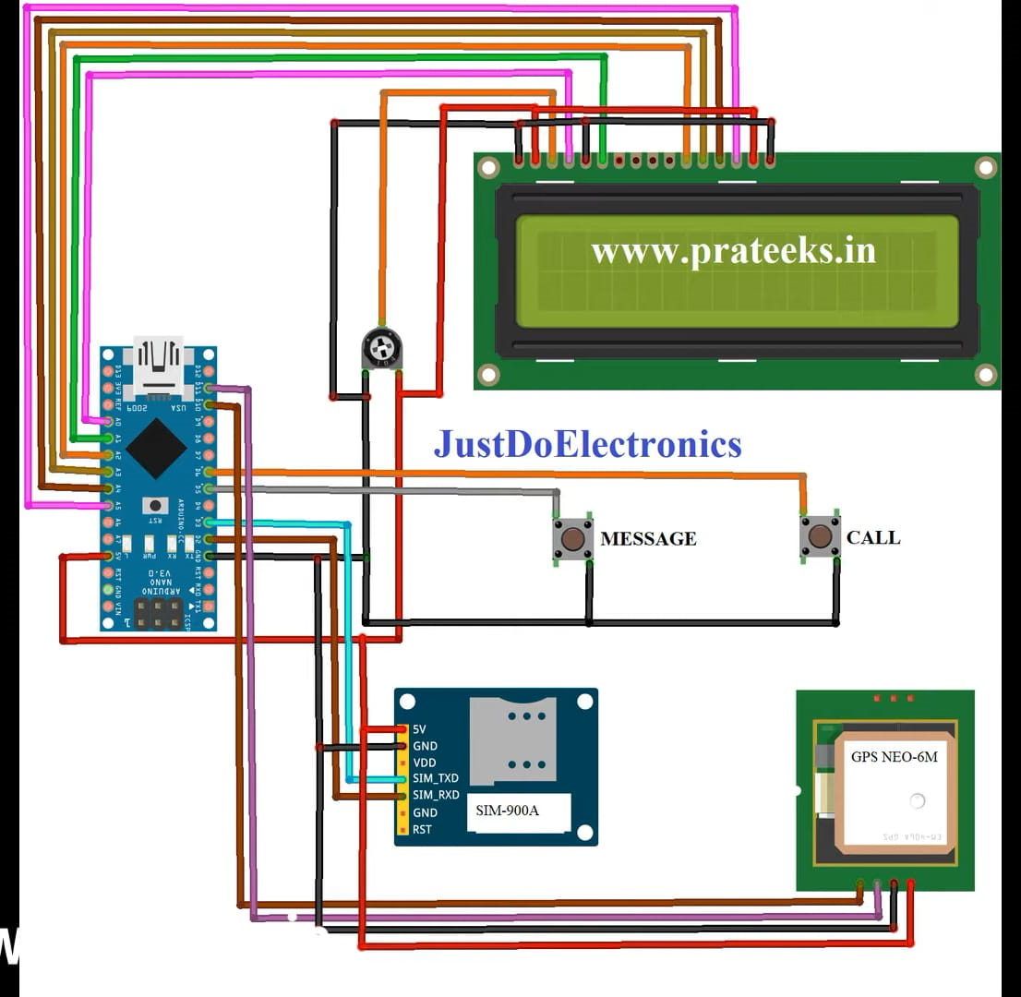
16x2 LCD DISPLAY
CIRCUIT
DIAGRAM

Slide 13
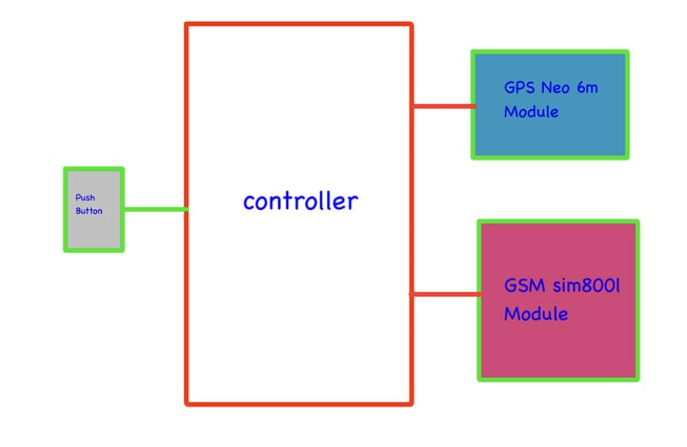
BLOCK DIAGRAM :

Slide 14
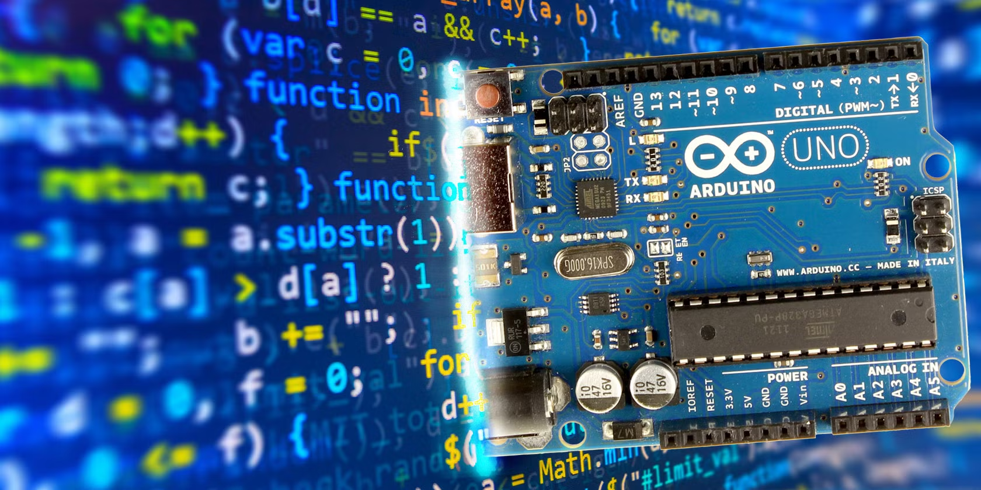
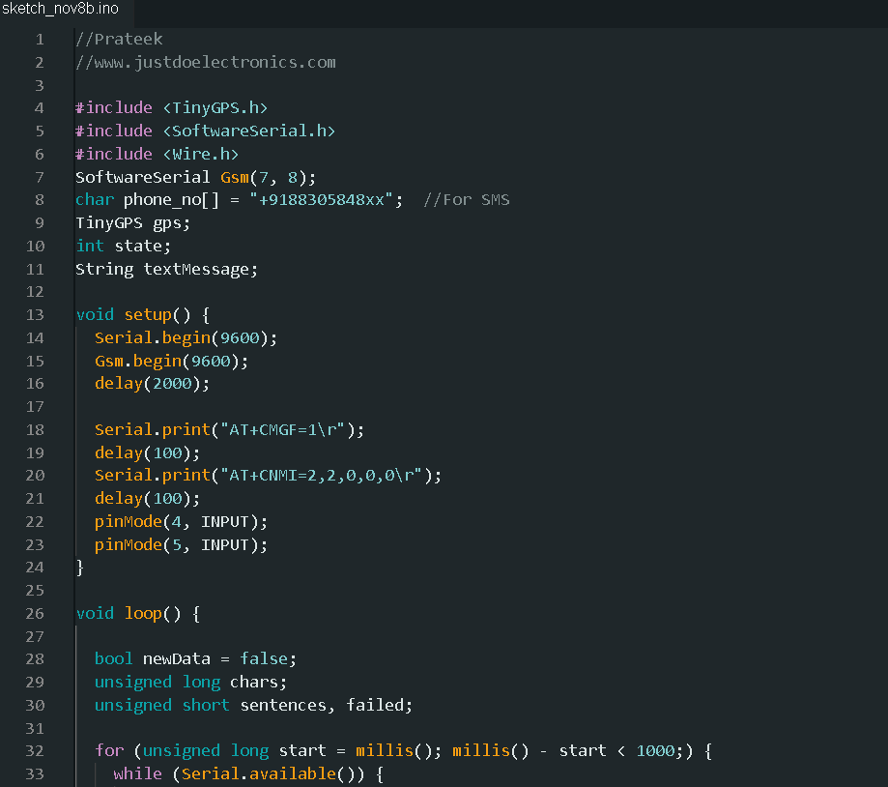
CODE OVERVIEW :
Code – Arduino IDE
Libraries : tiny GPS, software serial , wire
The code has been made when the push
Button is pressed
The location will sends to our mobile
It is made in Arduino IDE platform

Slide 15
Applications
Real-Time Location Tracking
Emergency Location Sharing: If the user is in danger, pressing the button sends their exact GPS coordinates via SMS to pre-configured contacts, helping family or authorities to respond quickly.
Continuous Tracking: It can continuously send location updates at intervals, useful in situations where constant monitoring is necessary for safety.
SOS Alerts for Rapid Assistance
Single-Button Emergency Alert: The emergency button can send a distress signal with the location, enabling a quick and discreet way to call for help in threatening situations.
Travel Safety Tool
Safety for Travelers: Useful for women traveling alone or in unfamiliar areas. The tracker provides peace of mind by allowing them to share their location with family or friends in real-time.

Slide 16
Conclusion :
In conclusion, the women safety Arduino GPS tracker is a valuable, accessible, and effective tool for enhancing personal security. By combining real-time GPS tracking, GSM communication, and an emergency button, this device provides quick location-sharing capabilities that can alert trusted contacts in case of emergencies. This project addresses the crucial need for safety and peace of mind, especially in uncertain or potentially dangerous situations. With further improvements, such as adding geofencing and optimizing battery life, it can be developed into a reliable, user-friendly solution for personal safety, making it a meaningful application of technology for social good.

Slide 17

"Empowering safety through technology—this women safety Arduino GPS tracker ensures that help is just a button away, bringing peace of mind and security wherever you go."

Slide 18


